Slide 1

An Interactive Introduction

Slide 2
Outlines
Appetizer
What? Why?
Building Blocks
Built-in Functions
Packages
Diving in deep – Titanic
What’s more on the Menu?
Q/A and Outro…

Slide 3
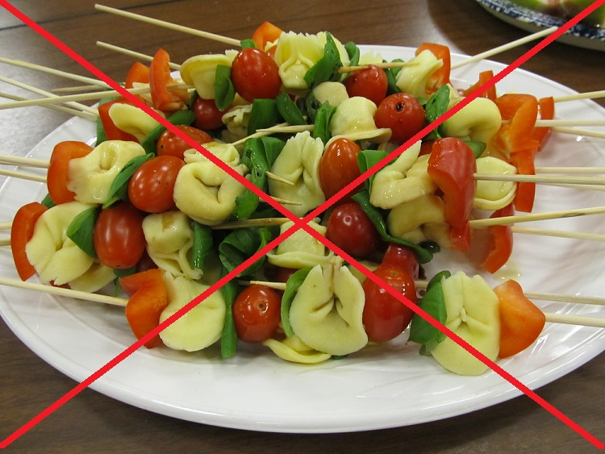
Appetizer

Slide 4
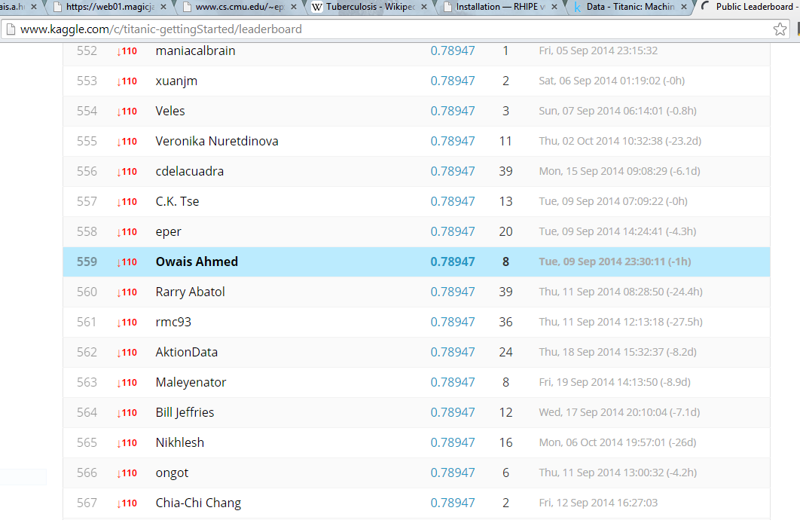

Slide 5
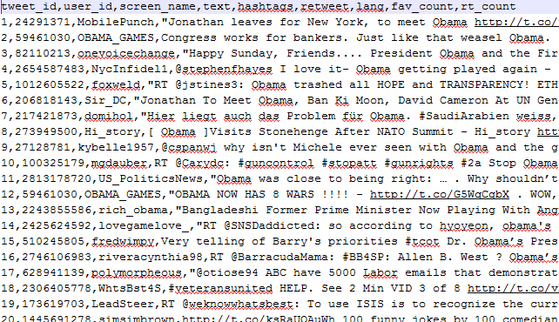
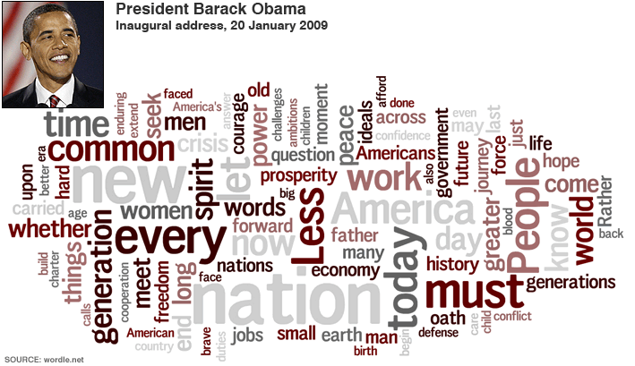
How many lines of code you need to transform raw tweets to a tag cloud? Make a guess…
Notes:
Meaning one command per line

Slide 6
Everything you need. Almost..
Open-source
Design of Scientists, by the Scientists, for the Scientists
Platform independent
Integration with Weka, Eclipse, you name it
IDEs: R IDE, RStudio, Revolution Analytics, …
Built-in datasets. 100+
Number of package. 10,000+ (190 per month)
Questions tagged ‘R’ on Stackoverflow.com. 206094
SPSS, KNIME, RapidMiner, Weka, … make a subset altogether

Slide 7
What?
Inspired by ‘S’ language by Bell labs in 1976
Initially written in 90’
C/C++ as the backbone
Interpreter-ish language
Compatible with every GNU system
Interactive + a system of OOP
Dynamic in nature

Slide 8
Why? (Advantages)
Fast
State of the art Algorithms
2nd on Graphics libraries after Matlab
Connections with APIs, Databases, Web services
Multi-threading ready
Big Data-ready
Genetics: a particular strength. 200+ dedicated packages

Slide 9
Why not? (Disadvantages)
Steep learning curve with minimal GUI – hard to learn, easy to forget
Requires some theoretical background
Debugging takes hit ‘n trial. Unless you go for commercial Revolution Analytics
Data preprocessing is messy
Always needs a reference library + users’ support
Does not obey Software Engineering practices
More addictive than Sugar (8 times more addictive than Nicotine)

Slide 10
Building blocks
Objects
Mode: R data type – character, numeric, logical, factor, list & function
Class: how R stores the objects – vector, matrix, data.frame & custom cases
Vector
Matrix
Array
List
Data Frame
Custom-class Objects
Workspace & I/O

Slide 11
Building blocks – Basics
> 2
[1] 2
> 2 + 2
> z <- 1:50
> x + y
[1] 1 3 5 7 9
> x * y
[1] 0 2 6 12 20
> x * z
[1] 0 2 6 12 20 0 7 16 27 40 0
[12] 12 26 42 60 0 17 36 57 80 0 22
[23] 46 72 100 0 27 56 87 120 0 32 66
[34] 102 140 0 37 76 117 160 0 42 86 132
[45] 180 0 47 96 147 200

Slide 12
Building blocks – Vector
A sequence of data elements of one type
Individual items are accessed via index, starting from 1
Can be initiated by:
c()
seq()
rep()
n:m
Values can have names too
> x <- c(0,1,2,3,4)
[1] 0 1 2 3 4
> x <- seq(5)
[1] 1 2 3 4 5
> x <- seq(5)
[1] 1 2 3 4 5
> x <- seq(1,5,by=0.5)
[1] 1.0, 1.5, 2.0, 2.5, 3.0, 3.5
> x <- 1:3
[1] 1 2 3
> x <- rep(1,times=5)
[1] 1 1 1 1 1
> x <- rep(c(1,2),times=5)
[1] 1 2 1 2 1 1 2 1 2 1 2
>names(x)<-c(‘one’,’two’,’three’)
one two three
1 2 3

Slide 13
Building blocks – Matrix
Matrix is a 2 x 2 vector exclusively
Has a dim attribute
Created by:
matrix(values, rows, columns)
cbind(vector1, vector2)
rbind(vector1, vector2)
Accessing specific rows & columns
matrix[row, ]
matrix[, col]
matrix[rows, columns]
> m<-matrix(1,nrow=3,ncol=3)
[,1] [,2] [,3]
[1,] 1 1 1
[2,] 1 1 1
[3,] 1 1 1
> m<-matrix(1:9,nrow=3,ncol=3)
[,1] [,2] [,3]
[1,] 1 4 7
[2,] 2 5 8
[3,] 3 6 9
> x<-1:3; y<4:6; m<-rbind(x,y)
[,1] [,2] [,3]
x 1 2 3
y 4 5 6
> m[1:2,1:2]
[,1] [,2]
x 1 2
y 4 5

Slide 14
Building blocks – Array
Vectors of ‘n’ dimensions
array(data, dimensions, names);
2^31 (2147483647) elements allowed in any dimensions
dim(array) fetches dimensions
array(data = 1:64, dim = c(4,4,4)) will build 4x4x4 array and set numbers from 1:64
> ar <- array(0,dim=c(2,3,4), dimnames=c("x","y","z"))
, , 1
[,1] [,2] [,3]
[1,] 0 0 0
[2,] 0 0 0
, , 2
[,1] [,2] [,3]
[1,] 0 0 0
[2,] 0 0 0
, , 3
[,1] [,2] [,3]
[1,] 0 0 0
[2,] 0 0 0
, , 4
[,1] [,2] [,3]
[1,] 0 0 0
[2,] 0 0 0

Slide 15
Building blocks – List
Store more than one type of data
Values can be vectors
Mode (type) is dynamic (autocasting)
Accessing data is tricky:
ls[dimension] gives dimension and vector or values
ls[[dimension]] gives vector of values
> ls <- list(c(1,2,3), c(log(1),sqrt(2),cosh(9)), c("log","sqrt","cosh"))
[[1]]
[1] 1 2 3
[[2]]
[1] 0.0 1.4 4051.5
[[3]]
[1] "log" "sqrt" "acos"

Slide 16
Building blocks – Data.frame
Data frames are lists of vectors of equal length
Rows have names, so do columns
Can be converted into matrix using by data.matrix()
Access columns with dataframe$column
Try mtcars (built-in database)
Querying:
mtcars[rows,columns]
mtcars[,columns]
mtcars[“Valiant”,]
mtcars[mtcars$gear == 4,]
> head(mtcars)
mpg cyl disp hp drat wt qsec vs am gear carb
Mazda RX4 21 6 160 110 3.9 2.6 16 0 1 4 4
Mazda RX4 Wag 21 6 160 110 3.9 2.9 17 0 1 4 4
Datsun 710 23 4 108 93 3.8 2.3 19 1 1 4 1
Hornet 4 Drive 21 6 258 110 3.1 3.2 19 1 0 3 1
Hornet Sportabout 19 8 360 175 3.1 3.4 17 0 0 3 2
Valiant 18 6 225 105 2.8 3.5 20 1 0 3 1

Slide 17
Building blocks – Workspace
> ls() # Lists all objects in memory
[1] ar x y m data list
> rm(object) # Remove objects from memory
> save(x, file=“Mydata.Rdata”) # Save objects to file
> getwd() # Get current working directory
[1] “C:/R64”
> setwd(“C:\\Learning R”)
> savehistory(file=“MyData.Rhistory”)
> loadhistory(file=“MyData.Rhistory”)
> history() # List previous commands

Slide 18
Building blocks – I/O (painfully easy)
> data <- read.csv(“filename”) # Reads a csv file
> data <- read.table(file="", header=FALSE, sep=",", quote=TRUE, stringsAsFactors=TRUE) # Reads a file with custom parameters
> write.csv(data, “filename”) # Writes data to file
# Btw, factors are like enumerations. Used for qualitative data

Slide 19
Built-in Functions
Statistical functions:
sum(), prod(), cumprod()
min(), max()
range()
mean(), median(), mode()
var(), sd()
cor()
summary()
Some more:
sort()
rank()
length()
nrow(), ncol()
log()
exp()
print()
scan()
as.numeric(). as.factor()

Slide 20
Packages
datasets: built-in datasets
stats: statistics
igraph: graphs and networks
cluster: clustering
arules: association rule mining
caret: classification and regression
nnet: neural networks
rjson: JSON for R
tm: text mining
sqldf: SQL on R data frames
Install package: install.packages(“package”)
Load package: library(package)
Unload package without restarting: detach("package:name", unload=TRUE)

Slide 21
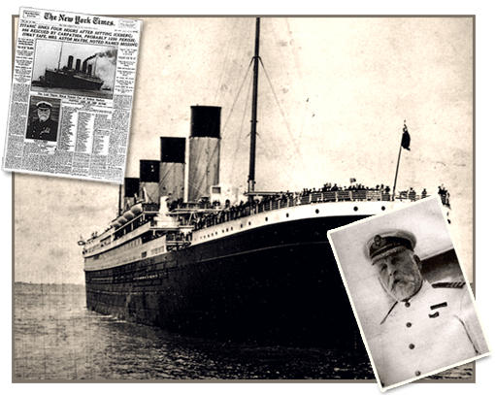
Diving in Deep – Titanic
RMS Titanic sank on April 15th, 1912 in its maiden voyage. Out of 2224 passengers on board, 1502 didn’t survive.
Want to know who survived?
If another event similar to Titanic happens, can you guess which passengers are likely to survive?

Slide 22
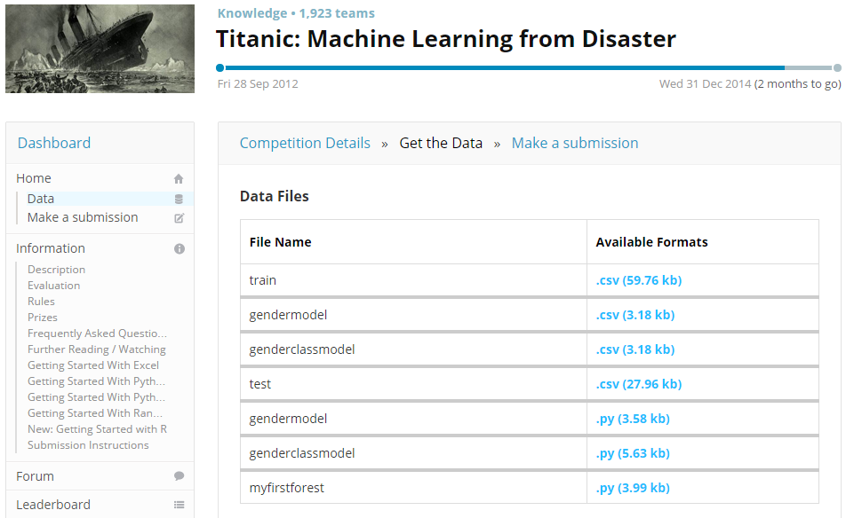
Download the dataset from: http://www.kaggle.com/c/titanic-gettingStarted/data
See how it looks like on MS Excel first

Slide 23
Download the dataset from: http://www.kaggle.com/c/titanic-gettingStarted/data
See how it looks like on MS Excel first
Set current working directory: setwd(“your path”)
Read the training dataset: dataset <- read.csv("train.csv")
List all variables: colnames(dataset)
Check basic data statis: summary(dataset)
“Women and children first” is a common rule in evacuation, check how data of survivors is distributed over these two variables. Use table() function to make a frequency table
dist <- table(dataset$Survived, dataset$Sex); plot(dist)
dist <- table(dataset$Survived, dataset$Age); plot(dist)
Oops! Messed up ☺. We’ll come to that
But how is Age itself distributed? barplot(table(dataset$Age)) # Normal?
Befriend you data

Slide 24
You should have noticed a few things:
Females survive mostly
Age needs discretization
Some attributes seem to be useless
Some data is missing

Slide 25
Here are our tasks:
Preprocessing
Applying model(s)
Evaluate performance

Slide 26
Preprocessing – Missing values
Age: ideas?
Let’s try the easiest way
missing <- is.na(dataset$Age) # is.na() is like isnull
mean.age <- mean(dataset$Age[!missing]) # Find out mean age
dataset$Age[missing] <- mean.age # Fill missing values
Embarked: quite easy
Check missing records: dataset[dataset$Embarked == '',]
Make distribution table: table(dataset$Embarked)
Fill the missing: dataset$Embarked[dataset$Embarked == ''] <- 'S'

Slide 27
Preprocessing – Discretization
Age and Fare can be Discretized
But before that…

Slide 28
Pause! We missed something important…

Slide 29
Apply()
These functions are like loops that traverse and apply some function to each element in a vector/array/matrix
apply(): used when dealing with matrix or array
m <- matrix(1:4, 2, 2) # Create a 2x2 matrix with values ranging from 1-4
apply(m, 2, mean) # Calculate means of dimension 2 (columns)
apply(m, 1, sum); # Calculate sums of dimension 1 (rows)
What about our own function?
apply(m, 1, function(x) {x*x}) # Square each element
Tip: change the dimension to 2 and try to figure out what’s happening

Slide 30
More: lapply() and sapply()
Both are designed to traverse on vectors and lists
Difference! lapply() returns a list and sapply() gives a vector
vec <- seq(from=0, to=180, by=30)
sapply(vec, function(x) cos(x)) # Gives a vector of 7 values
lapply(vec, function(x) cos(x)) # Gives 7 lists of 1 value each
You can forget that sapply() even exists if you use unlist(lapply()), which will turn the list into a vector
Now guess what the lines below would do?
ages <- dataset$Age
sapply(ages, function(x) { if(x <= 10) 'C' else if(x > 40) 'O' else 'Y' })

Slide 31
More: lapply() and sapply()
Why apply() when we have loops?
Save lines of code
Lambda functions (Lambda expressions in Java & C#)
Parallel vs Serial Processing
Finally! Aren’t they cool?
There are even more:
vapply() is especially for vectors and is faster
mapply() multivariative, i.e. when the function accepts multiple arguemnts
rapply() runs recursively on nested lists/vectors
tapply() to apply a function to subsets of a vector that are defined by some other vector

Slide 32
Resume! Preprocessing – Discretization
Age and Fare can be Discretized
Discretizing Age using sapply()
Let’s say < 13 are children, > 40 are old and the rest are young
ages.disc <- sapply(dataset$Age, function(x) {if(x<13) 'C' else if(x>40) 'O' else 'Y'})
dataset$Age <- ages
Fare: I leave it to you with a hint – summary()

Slide 33
Applying Model(s) – Decision Tree
Recursive Partitioning: rpart (http://www.mayo.edu/hsr/techrpt/61.pdf)
Load the package: library(rpart)
Find the best fit
rp_fit <- rpart(Survived ~ Pclass + Sex + Age + Fare + Embarked + SibSp + Parch, data=dataset, method="class")
To visualize the tree, we will use fancyRPlot package
library(rpart.plot)
library(rattle)
library(RColorBrewer)
fancyRpartPlot(rp_fit)

Slide 34
Applying Model(s) – Decision Tree
Validating the model
Split validation
Bootstrapping
K-fold validation
Cross validation
We’ll use split validation here
Say, we break the training set into 80-20 partitions
Pick 20% rows at random from dataset: random.rows <- sample(1:nrow(dataset), round(nrow(dataset)/80), replace=FALSE)
testset <- dataset[random.rows,]
Now remove these test records from original dataset
dataset <- subset(dataset, !(dataset$PassengerId %in% testset$PassengerId))

Slide 35
Applying Model(s) – Decision Tree
Retrain the model on dataset
Add a new column to test set, PredSurvived
testset$PredSurvived <- NULL
Apply prediction model learnt to test dataset
testset$PredSurvived <- predict(rp_fit, testset, type="class")
Match the Survived and PredSurvived
correct <- testset$PassengerId[testset$PredSurvived == testset$Survived]
What’s the accuracy of the model?
accuracy <- length(correct) / nrow(testset)
Now apply this model on test.csv and submit to Kaggle.com

Slide 36
What more on the menu?
Bayesian Networks
Naïve Bayes
Forests
Regression
Support Vector Machines
Association Rules
Neural Networks

Slide 37
What more on the menu?
K-means Clustering
Feature Engineering: Making useful what you thought was not
Classification for Missing values
Bootstrapping

Slide 38
?

Slide 39
References
A very brief introduction to ‘R’ – Matthew Keller
R tutorial - Eric Wajnberg (Wajnberg@sophia.inra.fr)
R tutorial slides – Tyler K. Perrachione, (tkp@mit.edu)
R basics – Ahmed Rebai
Stackoverflow – Joran (http://www.statisticalskier.com)
Trevor Stefans (http://trevorstephens.com)
Kaggle.com

Slide 40
THANK YOU…
For further queries: owaishussain@outlook.com
Do post your best Kaggle score to me
Send your feedback please…

